Slide 1
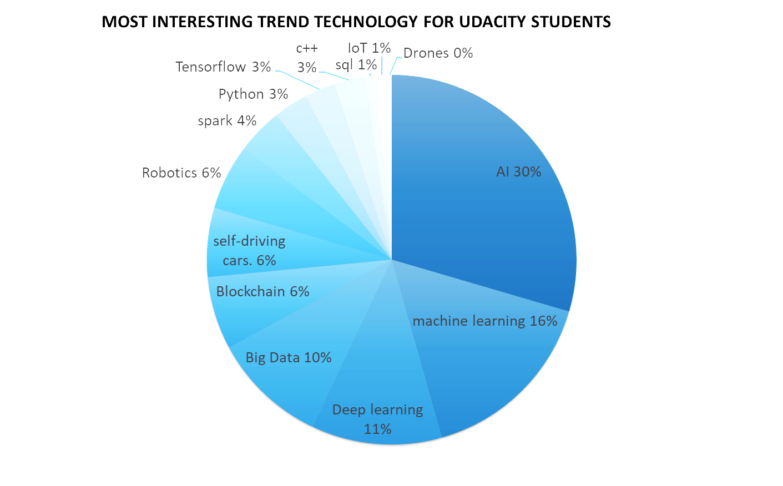
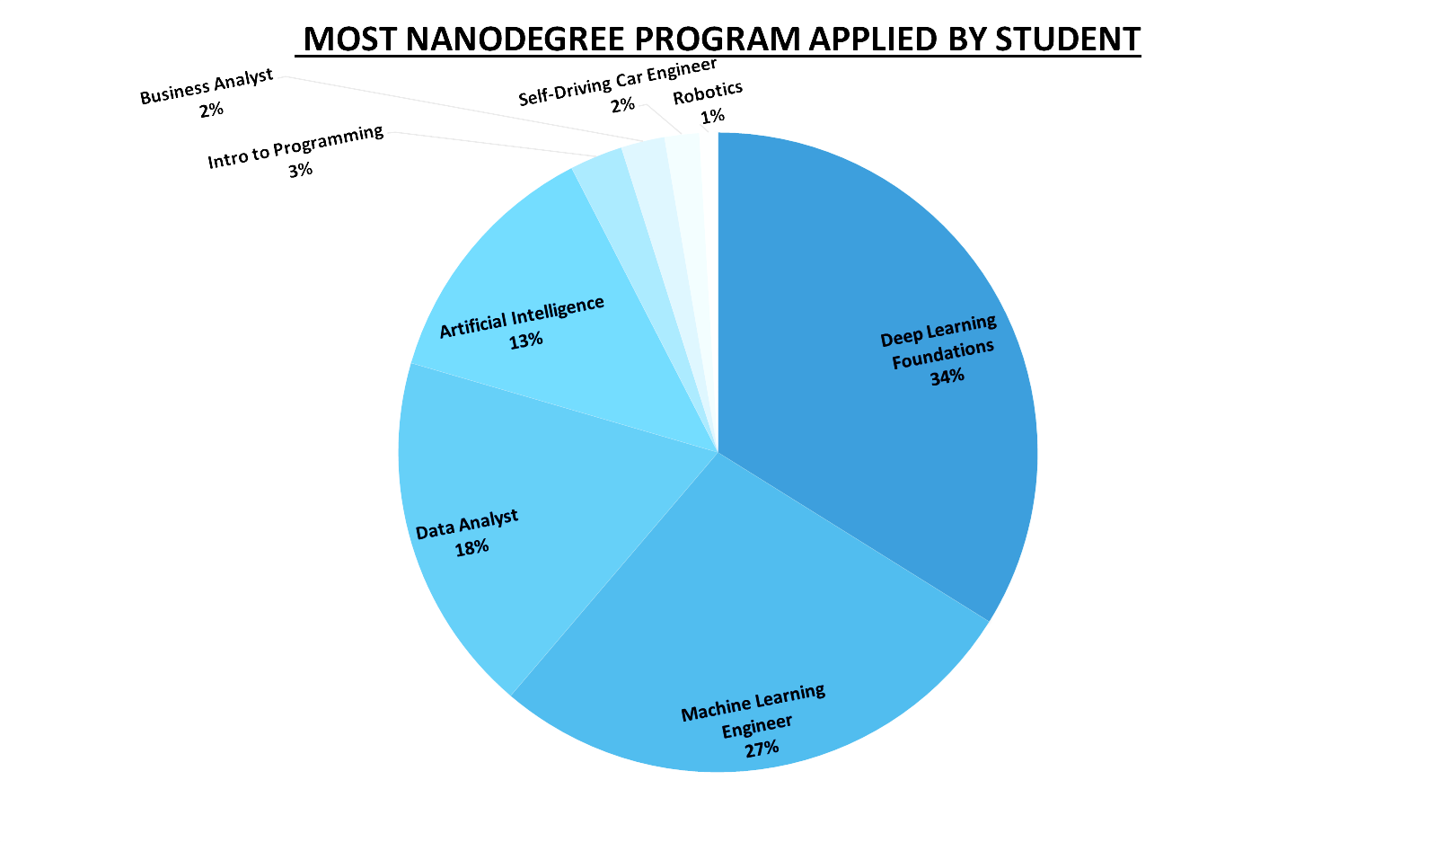
What is the most interesting trend technology for Udacity students?
From charts we can see student show interest in Ai field it grow up with 17% from what actually student applied and also self-driving car grow up (from 2% to 6%) , robotics(from 1% to 6%)
In addition, we see field like block chain and big data has popup as new target for students
And in the other way field like deep learning loss more than 60% from student interest, also machine learning has a big drop down
And we must consider that result reflect the sample of student they apply to survey not all Udacity student population Udacity

Slide 2
Does the status of students employed or unemployed and their education level play role in time to complete project?
Comparing the mean time to complete project according to education level (High school, nanodegree, master) For each group
Employed group (22.36, 21.28, 32.7) hours
& Unemployed group (27, 68.2, 49.46) hours
(We can see that employed group take short time than unemployed group to complete project
So yes, status of students & education level play role in time to complete project as the static of the data simple show.
Comparing the standard deviation, range and mean for student with nanodegree for each group
We will found that unemployed student with nanodegree have standard deviation (97.1) and mean (68.2) and that make the distance is big between them
,employed student with nanodegree have standard deviation (28.47) and mean (21.28) and that make the distance is too close between them
So employed student with nanodegree so closer to its mean than unemployed student
Also the unemployed student with nanodegree have range (315) is bigger than the other employed student rang (117)
That show us that unemployed student has outlier with extreme value than employed student
Moreover, if we look to their shapes we will found reflection to our data
That make Employed student with nanodegree group more concentrated around its mean value
<visualization or summary statistics used for finding>
Notes:
The standard deviation measures how concentrated the data are around the mean

Slide 3
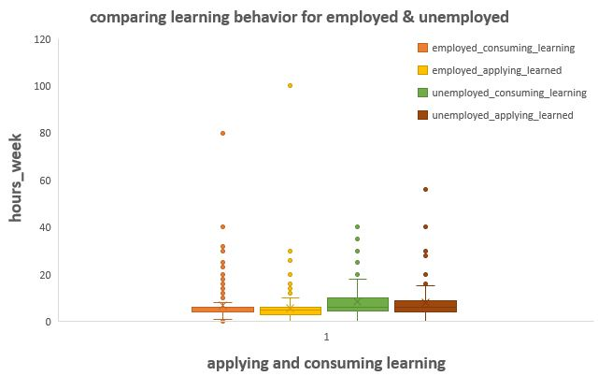
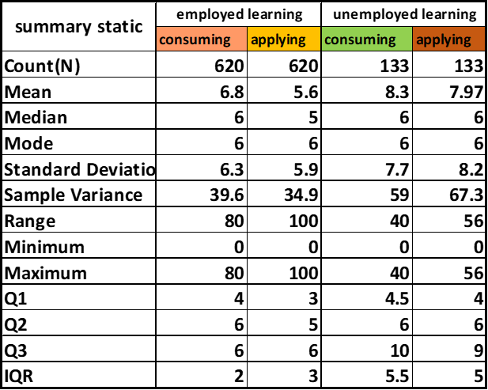
Does employment status affecting learning behavior?
In our data, value for
Mean is > the median
For employed & unemployed group in both applying and consuming learning so our data shape is skewed right
IQR for Employed & unemployed consuming learning is (2, 5.5)
Although they have same median, but different distribution
That mean unemployed group has more Variability in a data set than employed
We can say that unemployed learning behavior is more variability than employed
Notes:
IQR ignores data below the 25th percentile or above the 75th, which may contain outliers that could inflate the measure of variability of the entire data set.

Slide 4
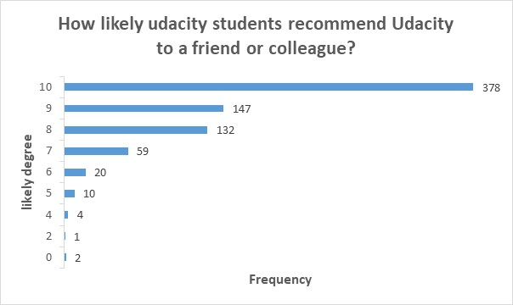
How likely students recommend Udacity to a friend or colleague?
<visualization or summary statistics used for finding>
If we look to result,
Mode for the result is 10 it count 378 times from 753 the number of sample student with 50.20%
We will see that more than 97% of students likely to recommend Udacity to their friend or colleague

